Slide 1
APPLICATION OF SEMI-SUPERVISED LEARNING IN HEALTHCARE domain
Presented by :-
Guided by :– Dr. Mala Dutta Chris Leivon David Rimo

Slide 2
CONTENTS
Introduction
Supervised learning
Unsupervised learning
Semi-Supervised Learning
Working of Semi-Supervised Learning
Advantages and disadvantages of Semi-Supervised Learning
Software and Libraries used
Dataset
Output

Slide 3
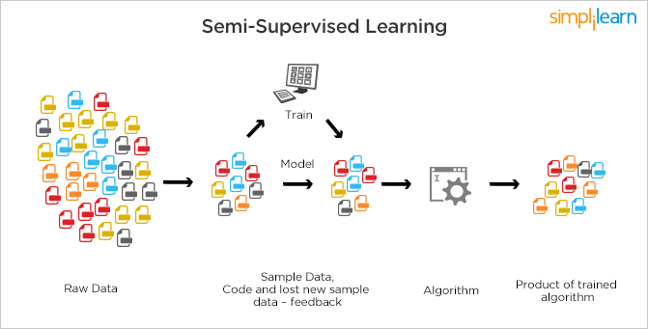
INTRODUCTION

Slide 4
Supervised Learning
It is defined by its use of labeled datasets to train algorithms that classify data or predict outcomes accurately.
As input data is fed into the model, it adjusts its weights until the model has been fitted appropriately, which occurs as part of the cross validation process.
Supervised learning helps organizations solve for a variety of real-world problems at scale, such as classifying spam in a separate folder from your inbox.

Slide 5
Unsupervised Learning
It uses machine learning algorithms to analyze and cluster unlabeled datasets.
These algorithms discover hidden patterns or data groupings without the need for human intervention.
Its ability to discover similarities and differences in information make it the ideal solution for exploratory data analysis, cross-selling strategies, customer segmentation, and image recognition.

Slide 6
SEMI-SUPERVISED LEARNING
Semi-Supervised learning is a type of Machine Learning algorithm that represents the intermediate ground between Supervised and Unsupervised learning algorithms. It uses the combination of labeled and unlabeled datasets during the training period.

Slide 7
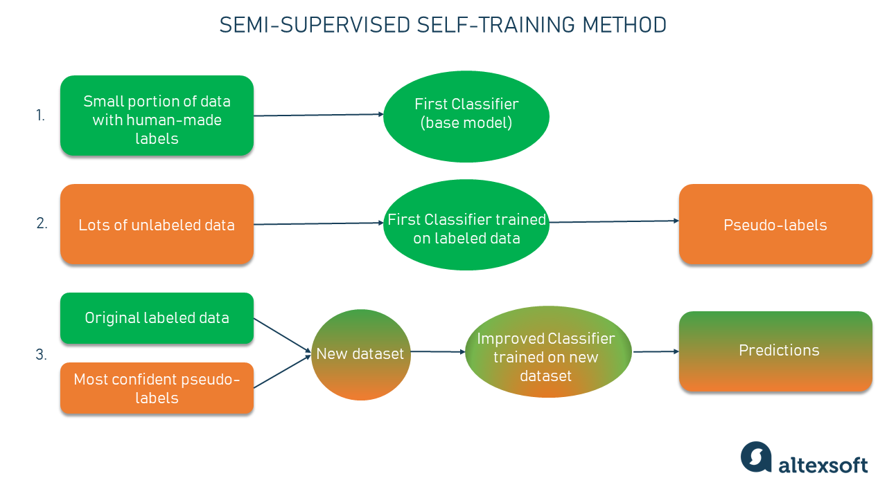
WORKING OF SEMI-SUPERVISED LEARNING

Slide 8
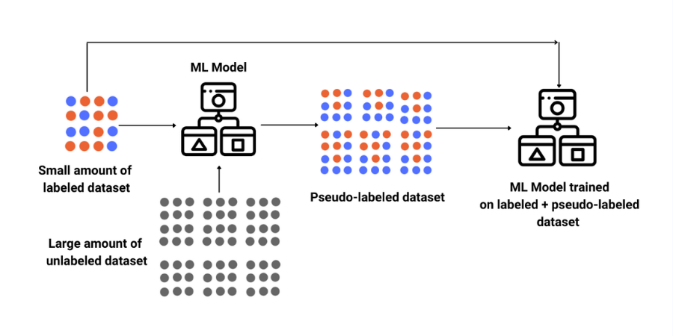
WORKING OF SEMI-SUPERVISED LEARNING

Slide 9
ADVANTAGES
Saves cost as well as time.
It reduces the amount of labelled data used.
It is simple.
It has high efficiency
Even with a small amount of labelled data, it can reduce computational resources and improve accuracy.

Slide 10
Libraries used:
Software used:
Jupyter notebook
Python 3
Pandas
Numpy
Matplotlib
Seaborn
Scikit learn

Slide 11
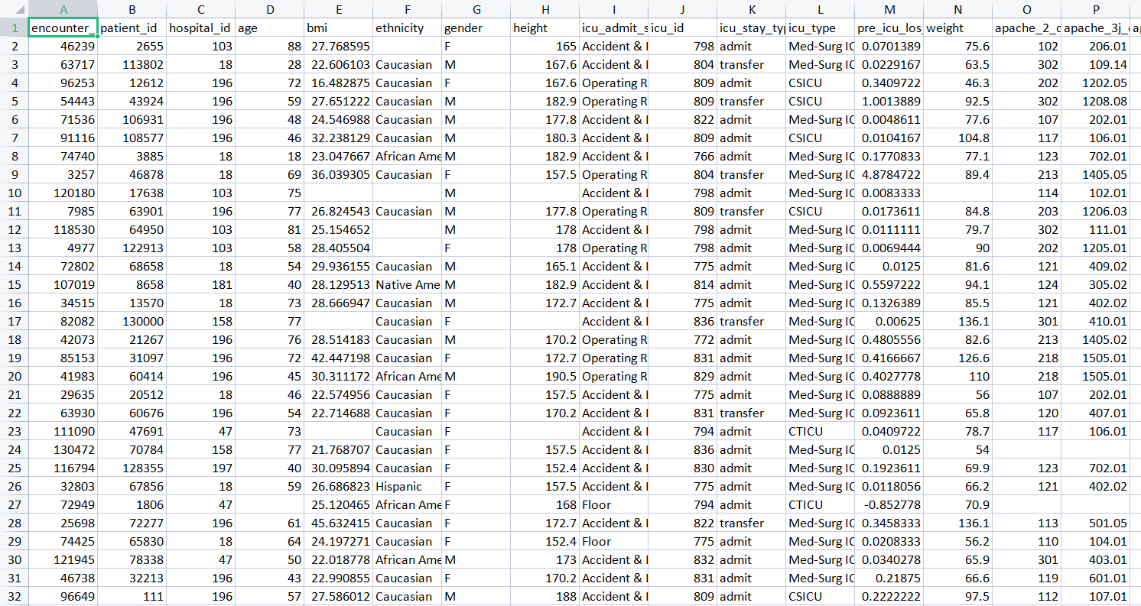
Dataset
There are two types of dataset used: Labeled dataset and Unlabeled datasets.
Labaled dataset consists of 11932 rows and 85 columns
Unlabeled dataset consists of 79783 rows and 85 columns

Slide 12
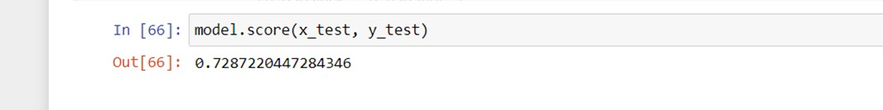
Output: Classification(Logistic Regression)
This is the output of Logistic Regression algorithm.
Logistic Regression is supervised learning
The accuracy is 72%

Slide 13
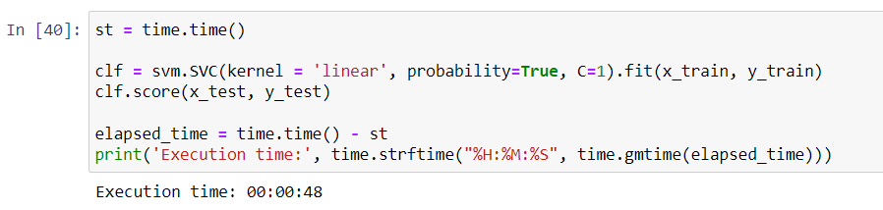
Output: code for obtaining pseudo-label

Slide 14
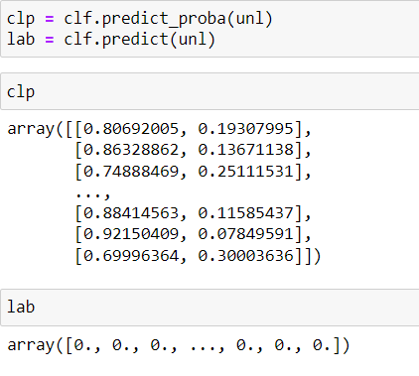
Output: Pseudo-label
This is the output after applying the unlabelled dataset into semi-supervised model.
The unsupervised dataset which has been labelled is called as pseudo-labelled.

Slide 15
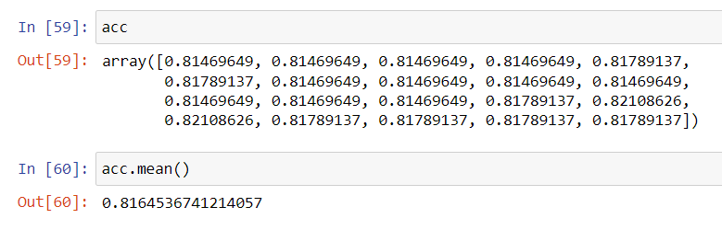
Output: Labelled + Pseudo label
This is the output of labelled and pseudo labelled
here, we iterate the accuracy for 20 times to gain more actual accuracy
The accuracy is 81% which is 9% higher than logistic regression

Slide 16

Thank you

